Slide 1
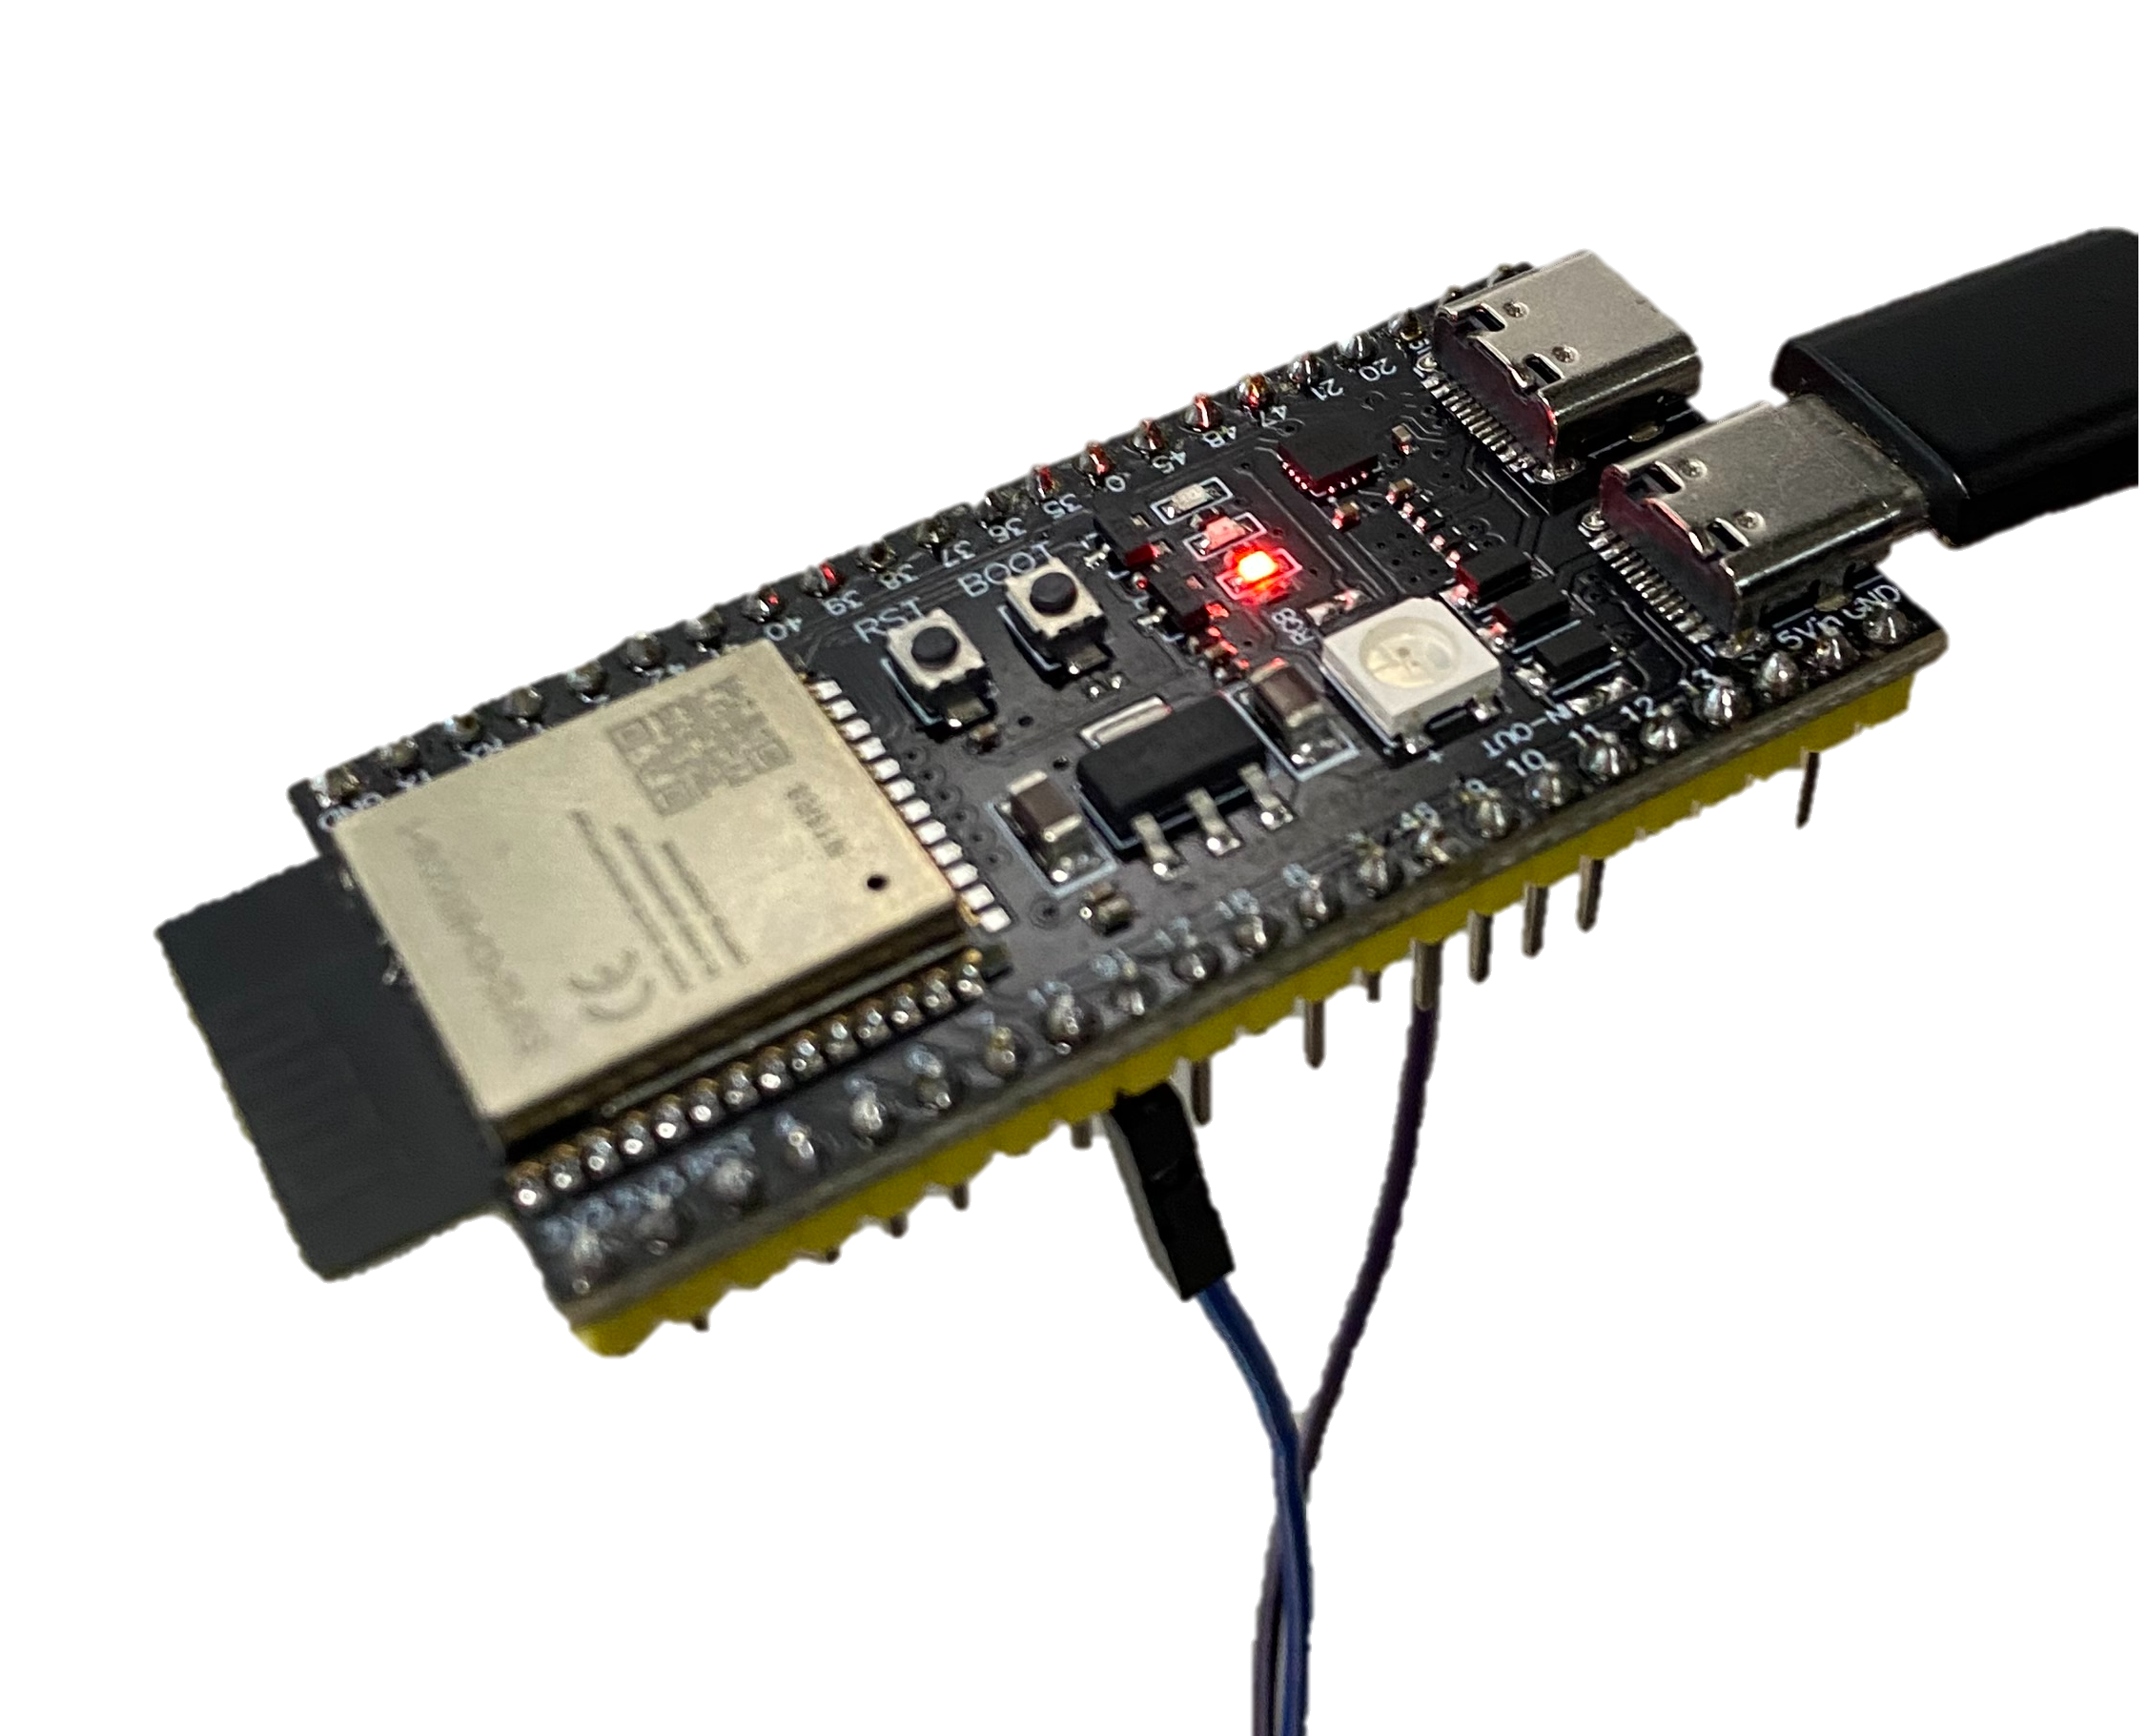
Weather Station IoT with ESP32
Hardware Integration and Web Platform Development
IOT PROJECT
ESP32
FULL-STACK DEVELOPMENT

Slide 2
Project Objectives
Functional Weather Station
Real-Time Data Collection
Complete IoT System
Continuously gather atmospheric measurements including temperature, humidity, wind patterns, and precipitation levels.
Build an end-to-end solution integrating embedded hardware with sophisticated web infrastructure and database management.
Develop a fully operational meteorological monitoring system capable of capturing environmental data with professional accuracy.

Slide 3
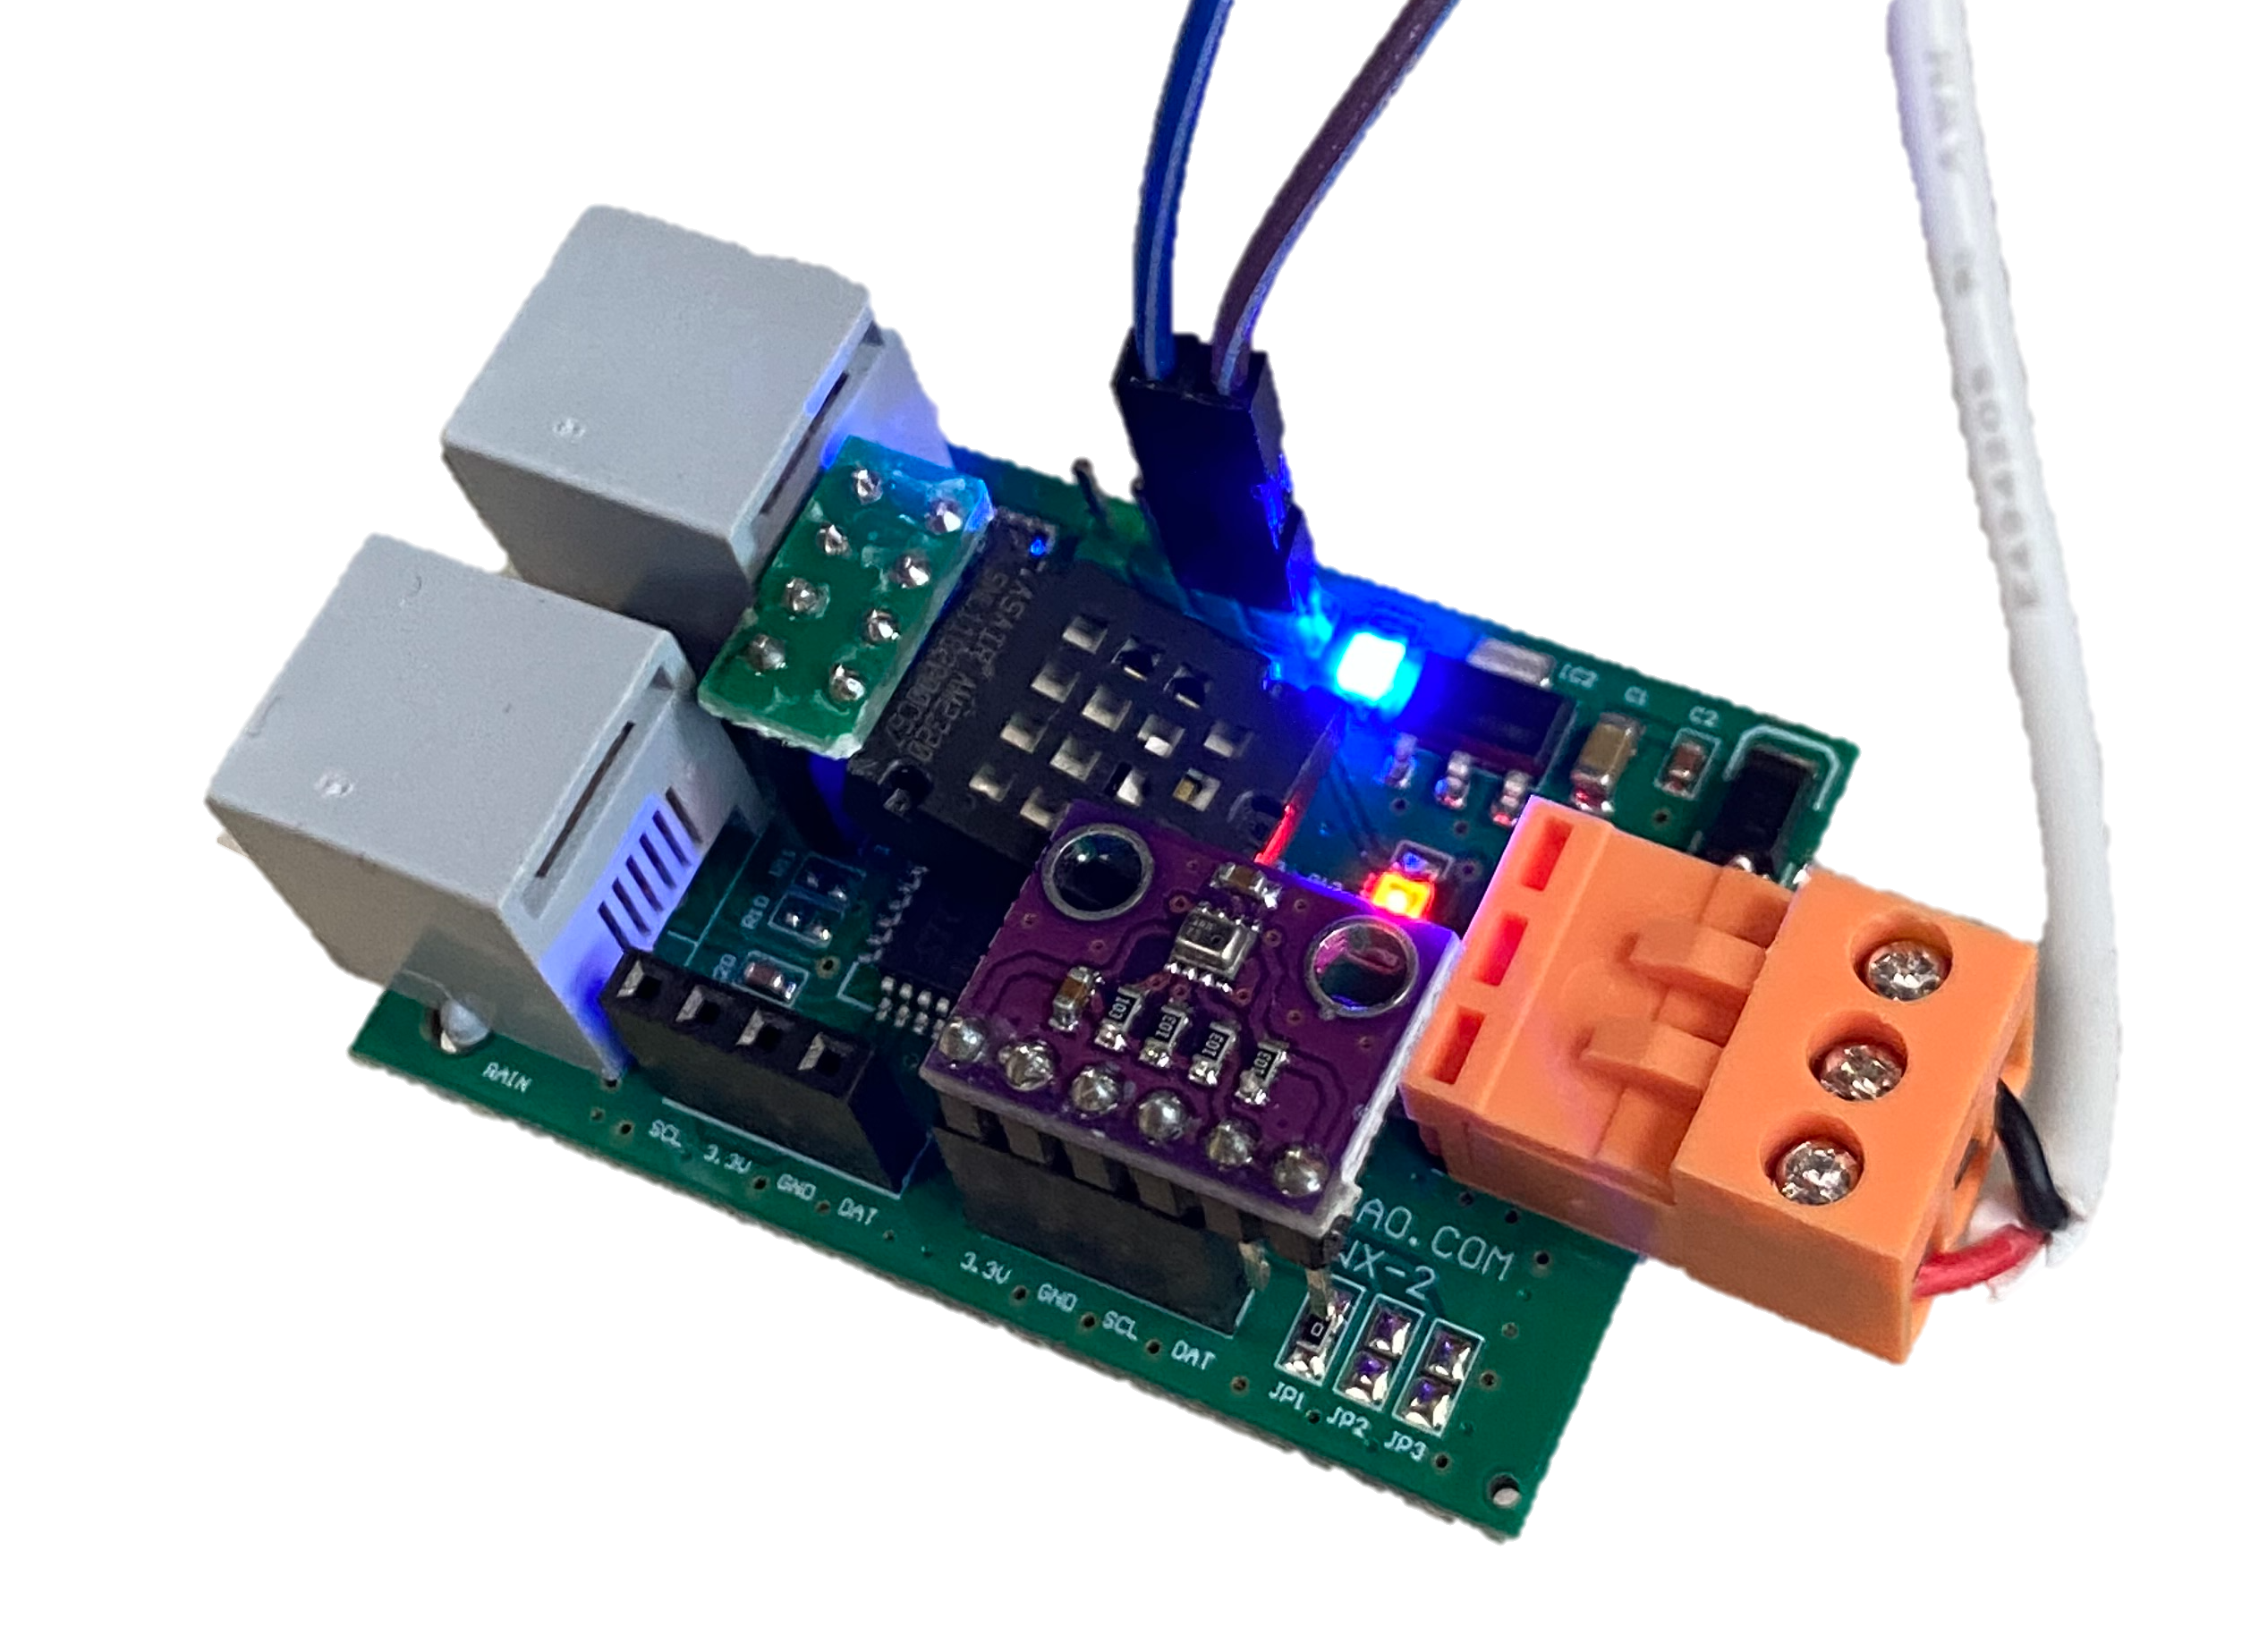
Hardware Components
Core Technology
The system is built upon two essential hardware components that work in harmony to capture and transmit meteorological data.
ESP32 Microcontroller
SEN0186 Interface Board
Dual-core processor with integrated WiFi and Bluetooth capabilities, providing robust connectivity and computational power for sensor data processing.
Professional-grade sensor suite measuring temperature, humidity, wind speed, wind direction, and precipitation with high precision.

Slide 4



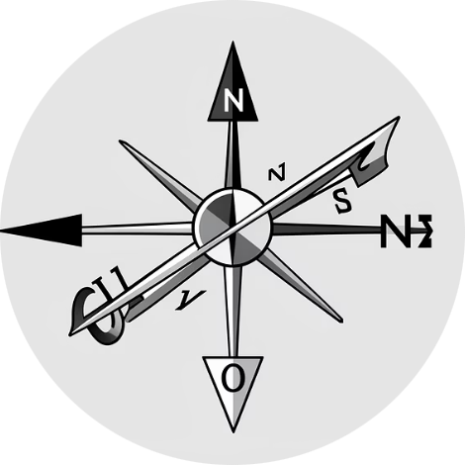

Sensor Capabilities
Temperature
Humidity
Wind Speed
Accurate ambient temperature readings with ±0.5°C precision for reliable climate monitoring.
Relative humidity measurement ranging from 0-100% to track atmospheric moisture levels.
Anemometer-based velocity measurement detecting wind speeds from 0-70 m/s with high responsiveness.
Wind Direction
Precipitation
360-degree wind vane providing precise directional readings across all compass points.
Tipping bucket rain gauge capturing rainfall data with 0.2794mm resolution for accurate totals.

Slide 5
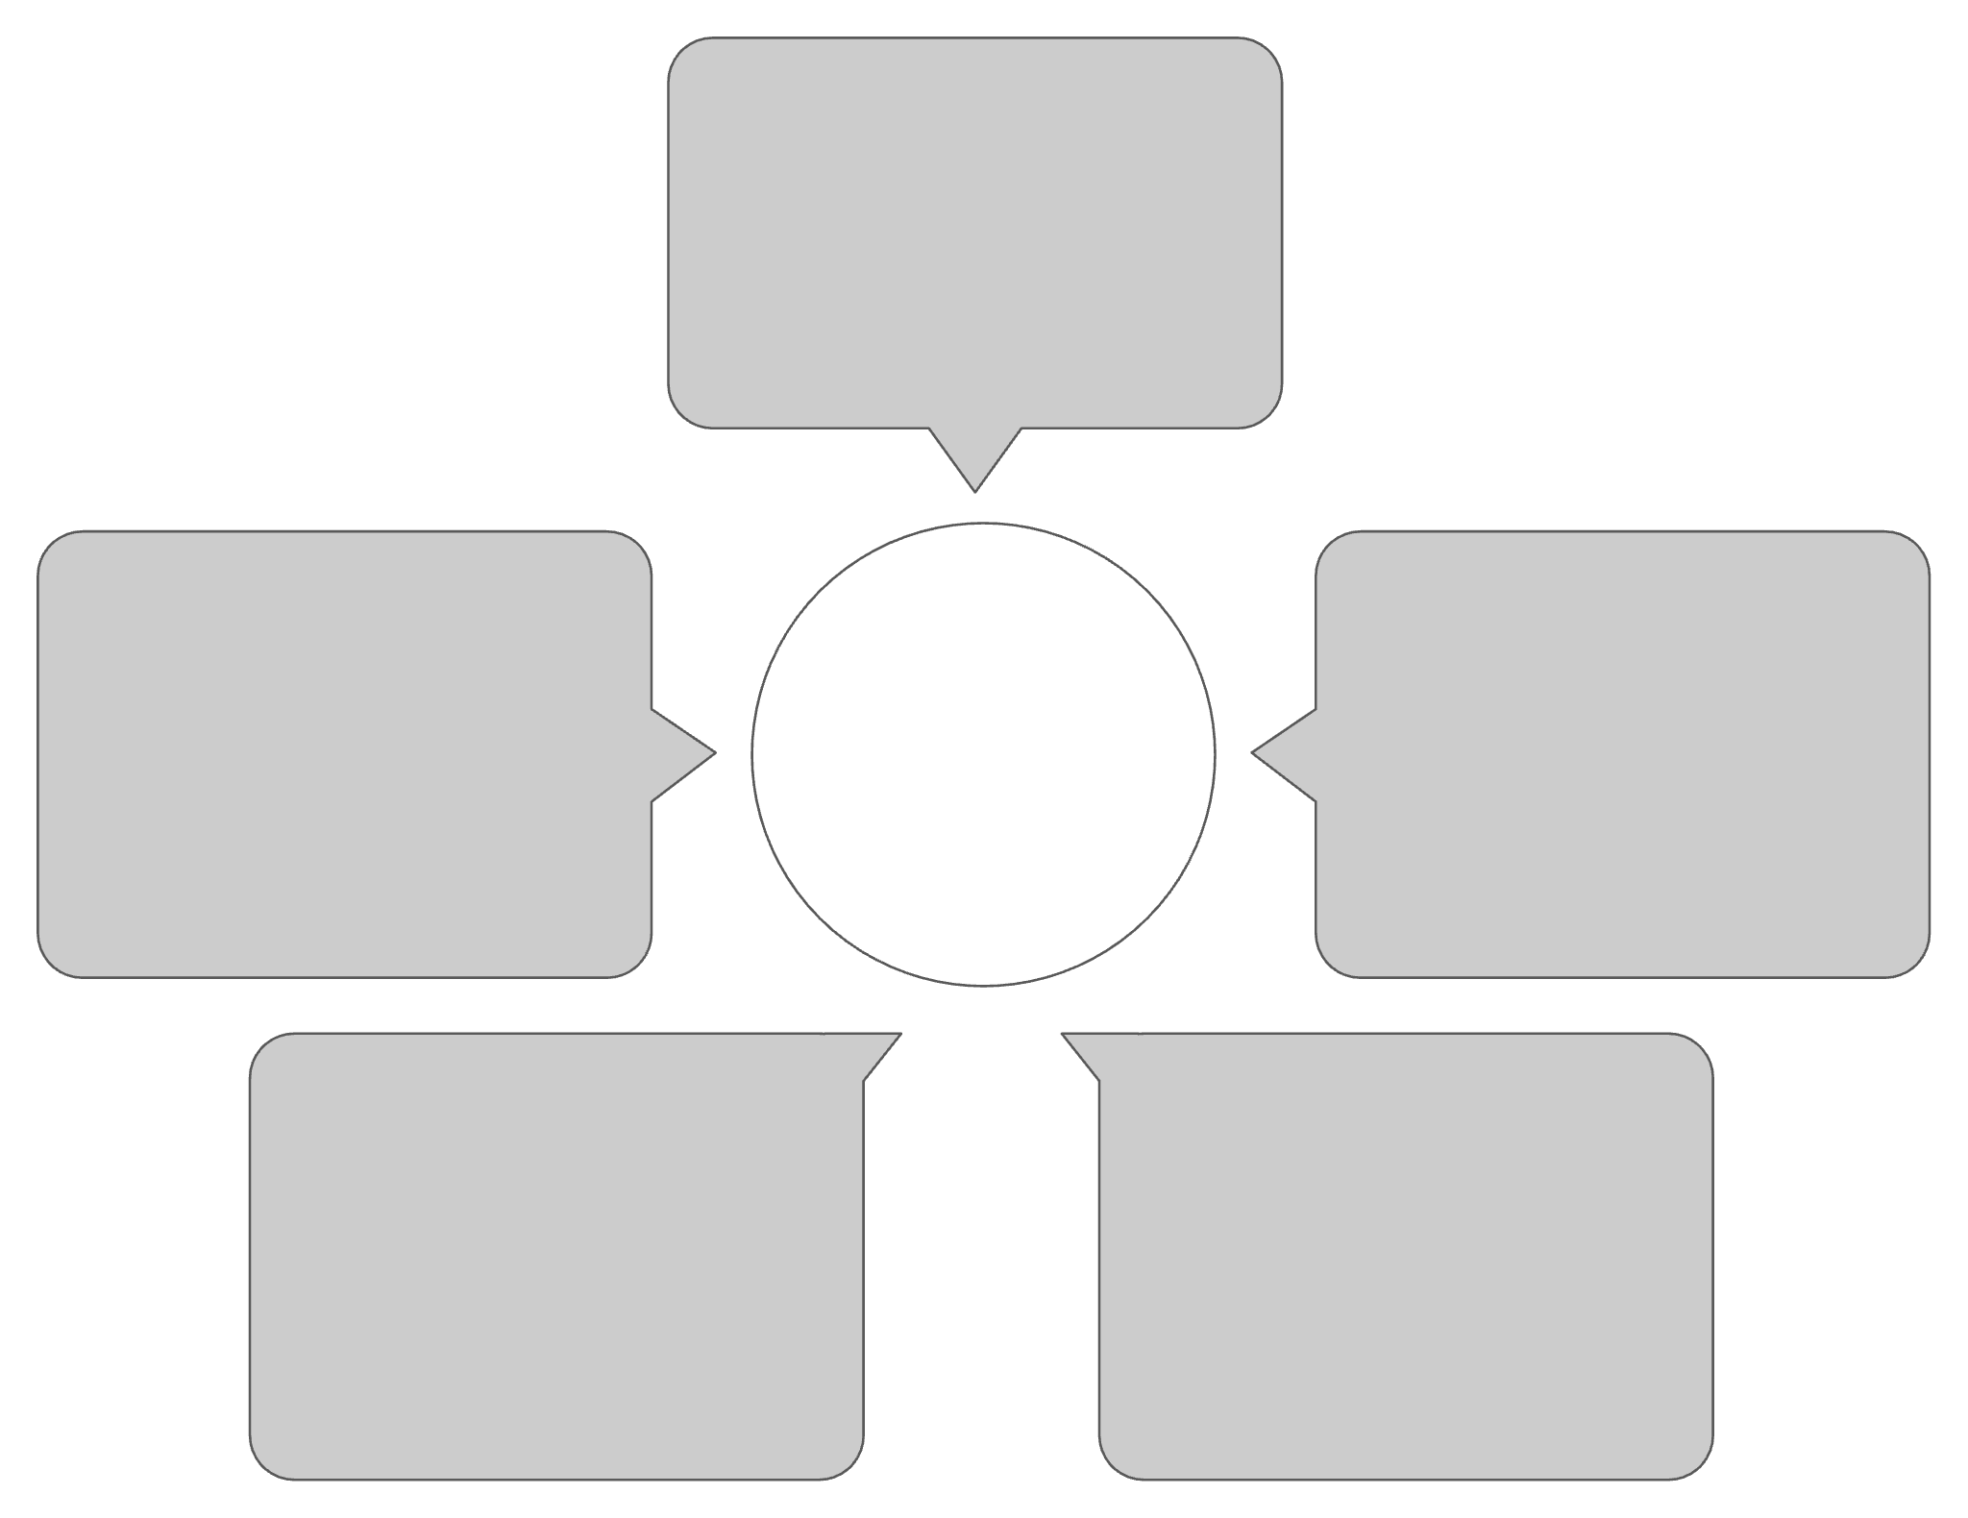
System Architecture
Environmental Sensors
Collect temperature, humidity
Real-time Sensor Data Flow
ESP32 Microcontroller
Web Dashboard
Visualize and control devices
Local processing and buffering
Backend API
WiFi Network
Ingests and validates data
Secure wireless transport
The architecture follows a streamlined data pipeline where environmental sensors feed real-time measurements to the ESP32 microcontroller. Data is processed locally, transmitted securely via WiFi to the backend API, and presented through an interactive web dashboard accessible from any device.

Slide 6
System Operation Workflow
01
02
03
Sensor Data Acquisition
Local Data Processing
Wireless Data Transmission
The ESP32 polls each sensor at configured intervals, typically every 30 seconds, collecting raw environmental measurements from all connected devices.
Raw sensor values undergo validation, calibration, and conversion to standard units within the microcontroller before transmission, ensuring data quality and consistency.
Processed measurements are packaged as JSON payloads and transmitted via secure WiFi connection to the backend API endpoint using HTTPS protocols.
04
Web Dashboard Visualisation
The frontend queries the database periodically, rendering live data updates, historical trends, and interactive charts for comprehensive weather monitoring.

Slide 7
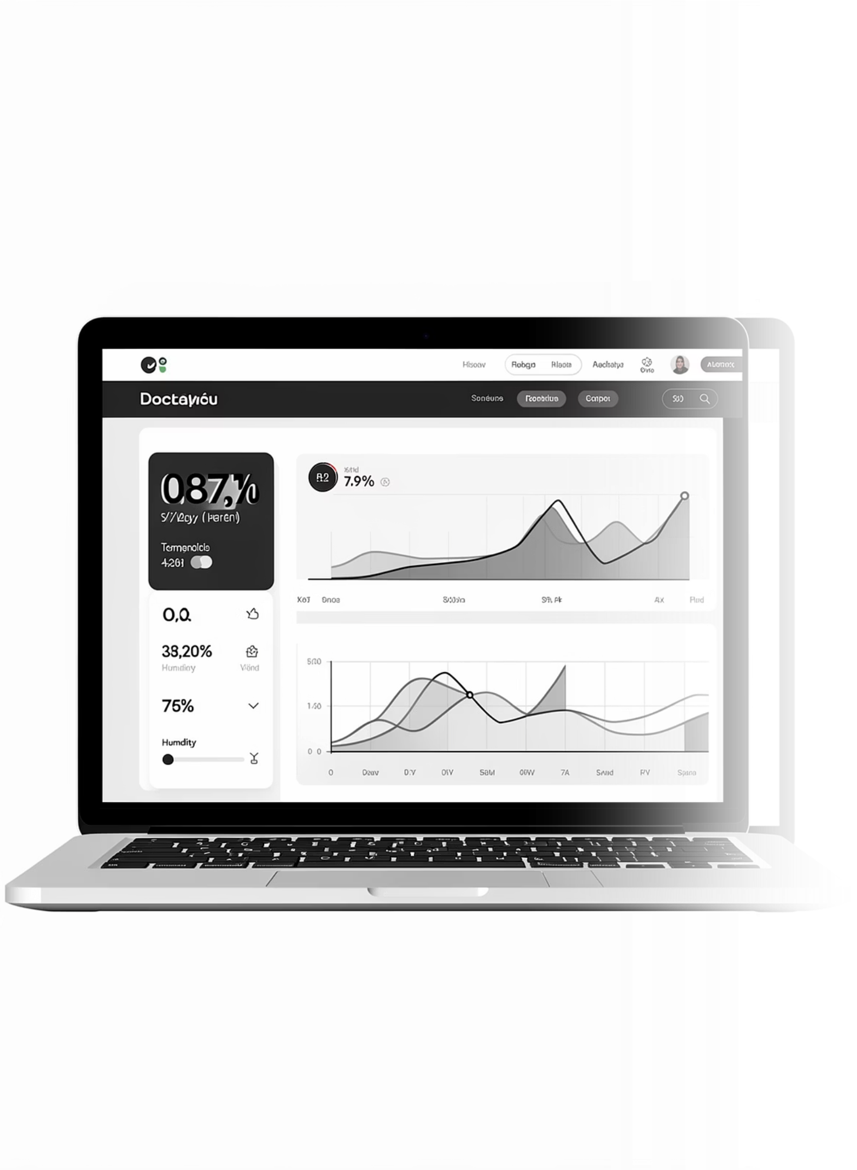
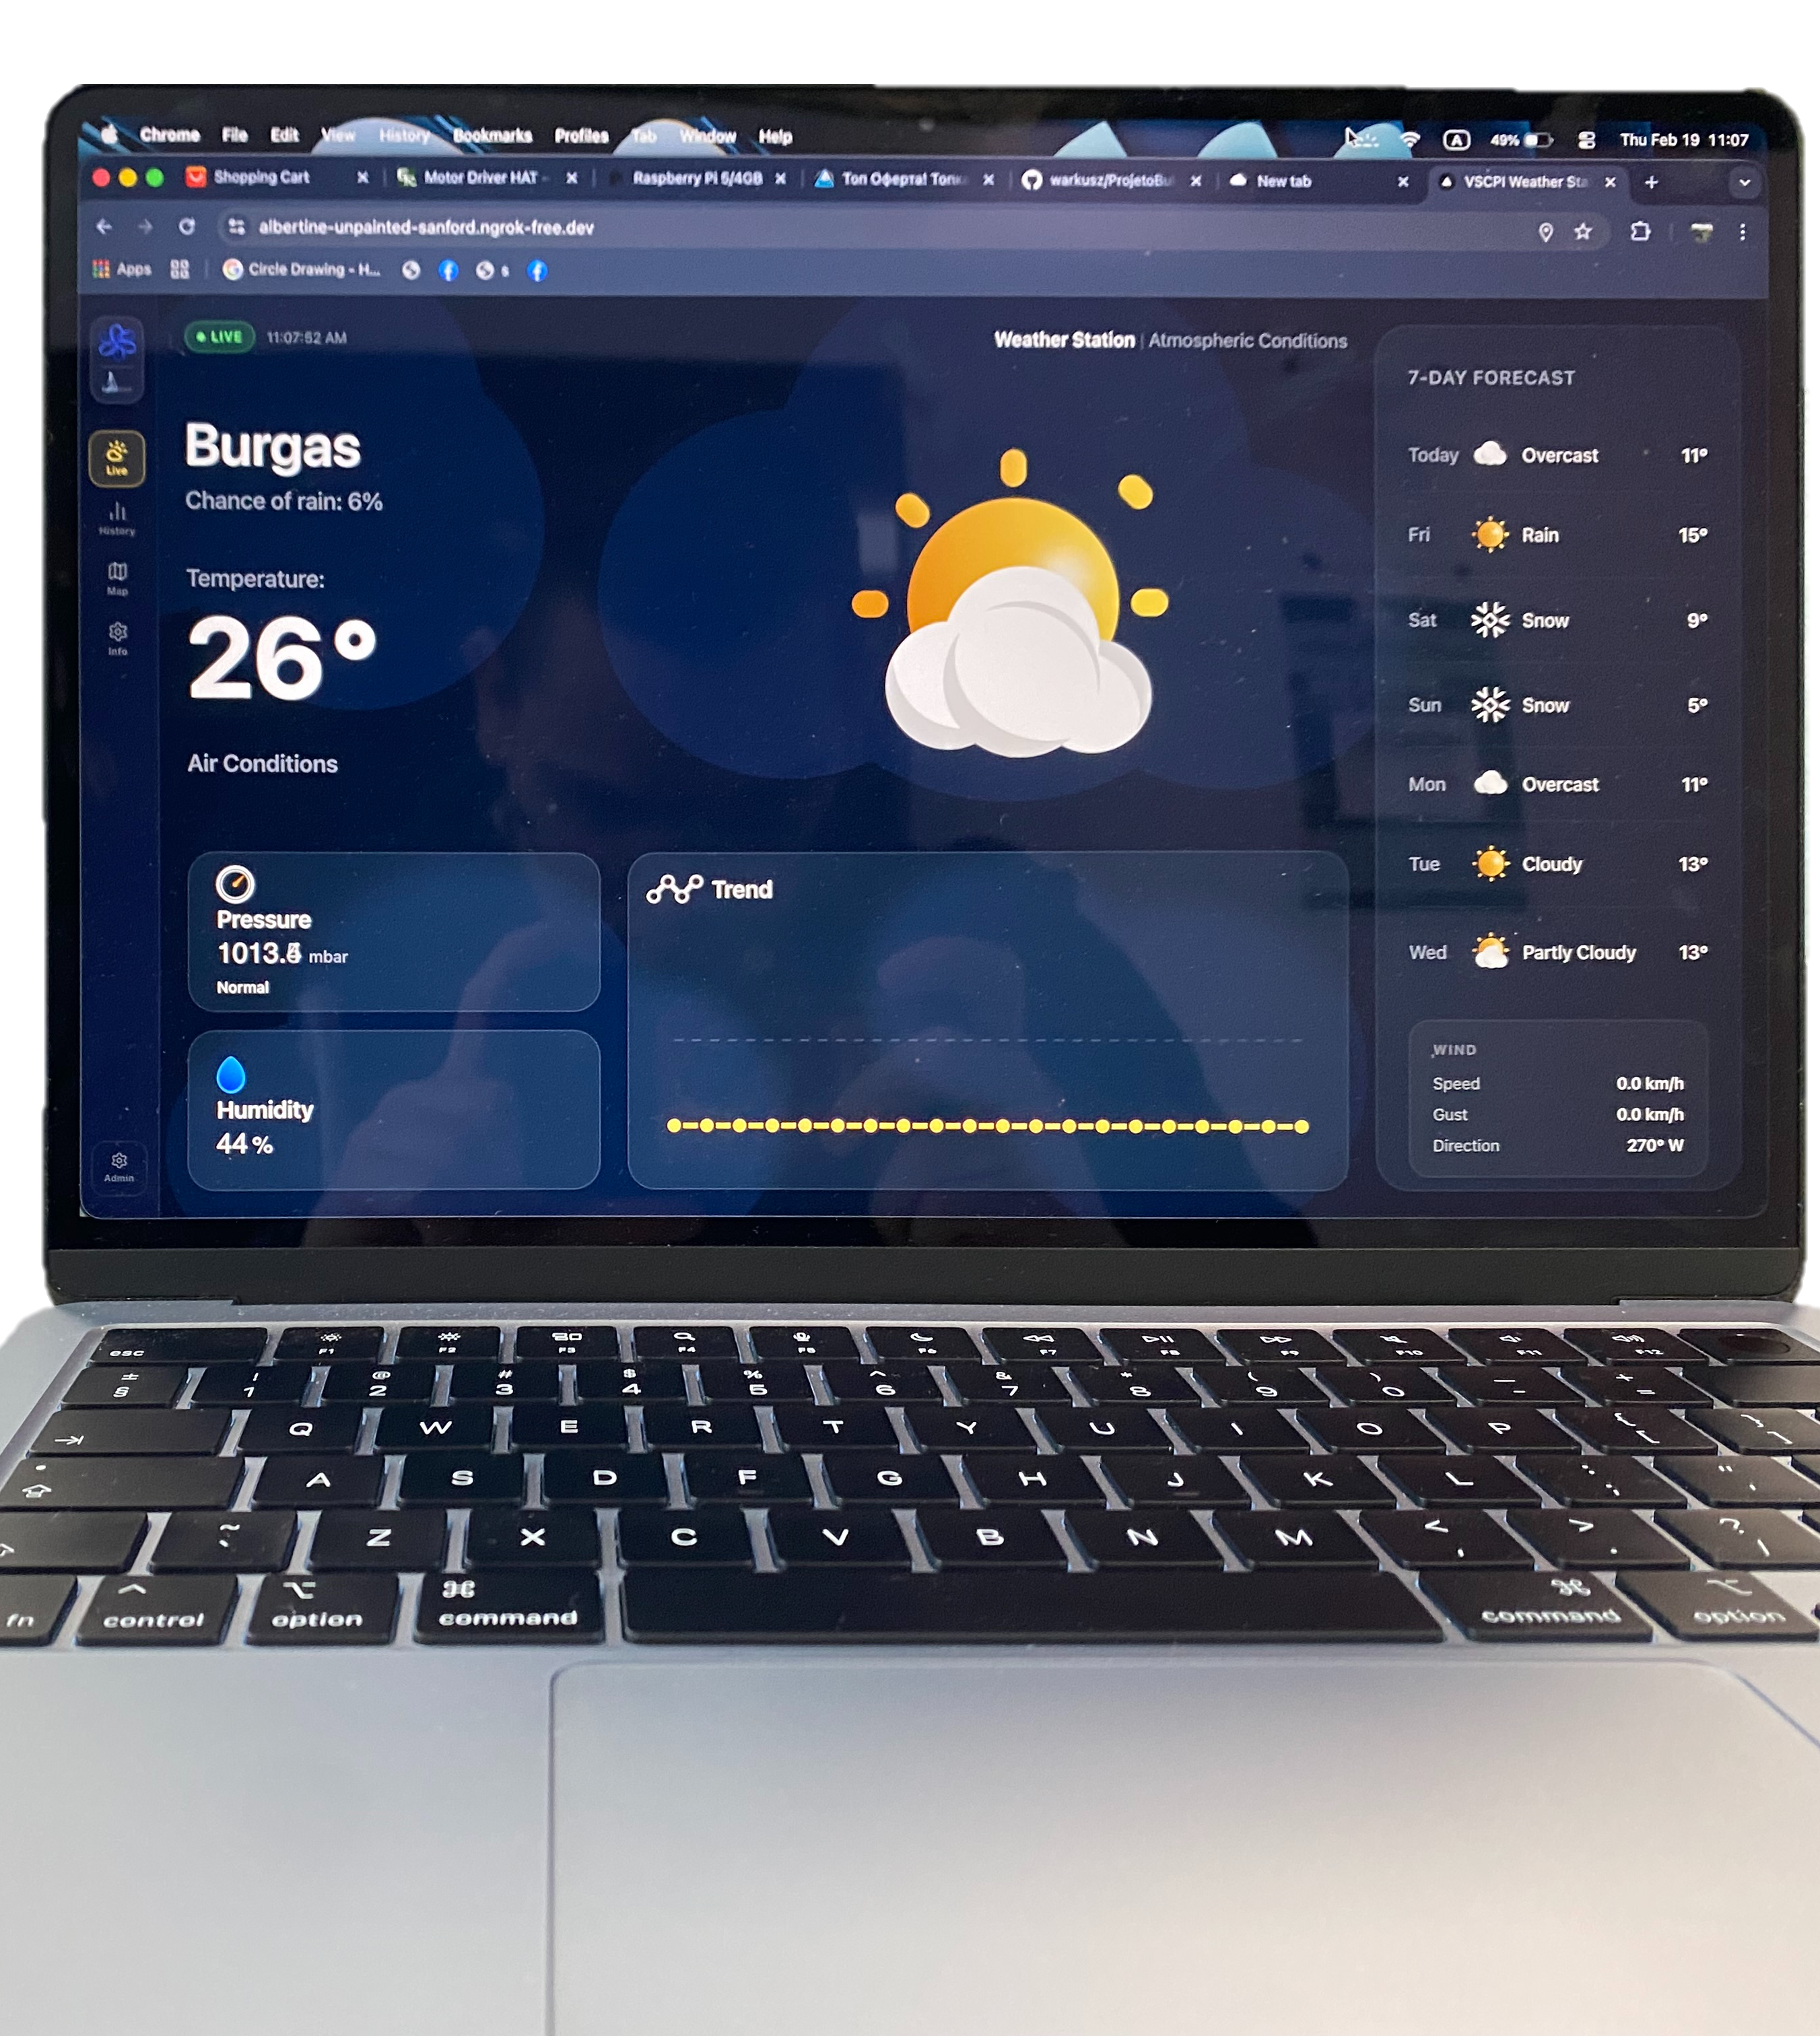
Frontend Dashboard
Meteorological Dashboard
Interactive Charts
Live Data Updates
Clean, intuitive interface displaying all weather parameters with colour-coded status indicators and alert thresholds.
Dynamic visualisations showing temperature trends, wind roses, humidity graphs, and precipitation totals using responsive chart libraries.
WebSocket connections enabling real-time refresh without page reloads, providing instant visibility of changing conditions.
Responsive Design
Mobile-first interface adapting seamlessly to smartphones, tablets, and desktop displays for monitoring on the go.

Slide 8

Project Outcomes and Results
Achievement Summary
The project successfully delivered a production-ready weather monitoring system demonstrating professional IoT capabilities.
Fully Operational System
Remote Accessibility
All hardware and software components functioning reliably with 99% uptime over testing period.
Data accessible from any location via web browser, enabling monitoring without physical presence.
Real-Time Performance
Scalable Architecture
Sub-second latency between sensor readings and dashboard updates providing instant awareness.
Modular design supporting expansion to multiple stations and additional sensor types.

